Slide 1


CLIP: Connecting text and images
EECS 598
Jiachen Liu
2024/1
Notes:
CLIP is the first multimodal model, that bridges the gap between text and images understanding
Clip has inspired many other multimodal works or image generation
understanding CLIP is a prerequisite for all of its follow-up works
Compare to tuesday lecture, this lecture would be mostly about ML algorithm rather than system related aspects

Slide 2
Agenda
What is CLIP?
How does CLIP work?
Why CLIP matters?

Slide 3

CLIP (Contrastive Language-Image Pre-Training) is a neural network trained on a variety of (image, text) pairs.
It can be instructed in natural language to predict the most relevant text snippet given an image, without directly optimizing for the task, similarly to the zero-shot capabilities of GPT-2 and 3.
https://github.com/openai/CLIP
Notes:
This is the definition from original paper, which accurately capture

Slide 4
What is CLIP?
Open Source: The model is created and open-sourced by OpenAI.
Multimodal: CLIP combines Natural Language Processing and Computer Vision.
Contrastive Learning: CLIP is trained on a huge dataset of 400 million (image, text) pairs collected from the internet
With Contrastive Learning, CLIP is trained to learn that similar text-image should be close in the latent space, while dissimilar ones should be far apart.
Zero-shot learning enables the generalization of unseen labels, without having explicitly trained to classify them.
For example, all ImageNet models are trained to recognize 1000 specific classes. CLIP is not bound by this limitation.
Notes:
It is trained on 400,000,000 (image, text) pairs. An (image, text) pair might be a picture and its caption. [ImageNet has 1.2 million training dataset]
"It can predict the most relevant text snippet, given an image." You can input an image into the CLIP model, and it will return for you the likeliest caption or summary of that image.
"without directly optimizing for the task, similarly to the zero-shot capabilities of GPT-2 and 3." Most machine learning models learn a specific task. For example, an image classifier trained on classifying dogs and cats is expected to do well on the task we've given it: classifying dogs and cats. We generally would not expect a machine learning model trained on dogs and cats to be very good at detecting raccoons. However, some models -- including CLIP, GPT-2, and GPT-3 -- tend to perform well on tasks they aren't directly trained to do, which is called "zero-shot learning."
"Zero-shot learning" is when a model attempts to predict a class it saw zero times in the training data. So, using a model trained on exclusively cats and dogs to then detect raccoons. A model like CLIP, because of how it uses the text information in the (image, text) pairs, tends to do really well with zero-shot learning -- even if the image you're looking at is really different from the training images, your CLIP model will likely be able to give a good guess for the caption for that image.
- a neural network model built on hundreds of millions of images and captions,
can return the best caption given an image, and
has impressive "zero-shot" capabilities, making it able to accurately predict entire classes it's never seen before!

Slide 5
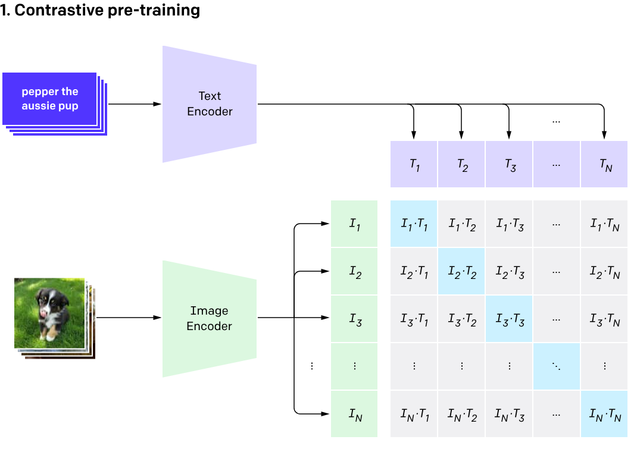
How does Contrastive Language-Image Pre-Training Work?
Transformer
Resnet, ViT
https://openai.com/research/clip
Notes:
Let us look at how CLIP connect text with image. You may need to Pay 100% your attention to understand CLIP
CLIP objective
What is inside the encoder
Cosine similarity
Maximize diagonal similarity, while..
Contrastive learning significantly increase the amount of training data, by introducing dissimilar image-text pairs

Slide 6
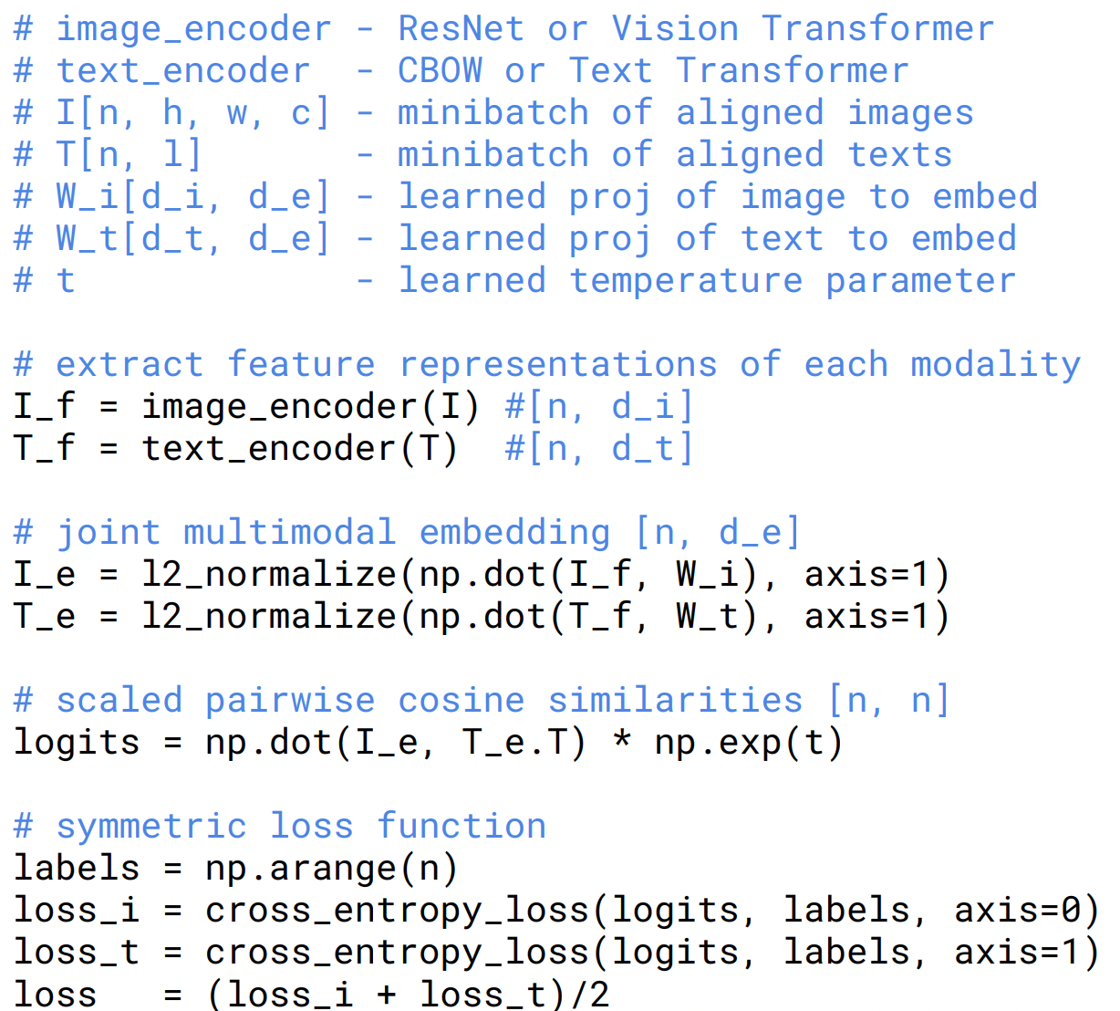
How does Contrastive Language-Image Pre-Training Work?
Learning Transferable Visual Models From Natural Language Supervision
Notes:
Based on this intuition, CLIP design its loss function accordingly
loss_i is the cross-entropy loss calculated when the model tries to match each image with the correct textual description. In this case, the image acts as an anchor, and the model looks across all text descriptions (in a batch) to find the matching one.
The total loss for the CLIP model is the average of these two losses: (loss_i + loss_t) / 2. This combination ensures that the model is equally good at matching images to text and text to images.

Slide 7
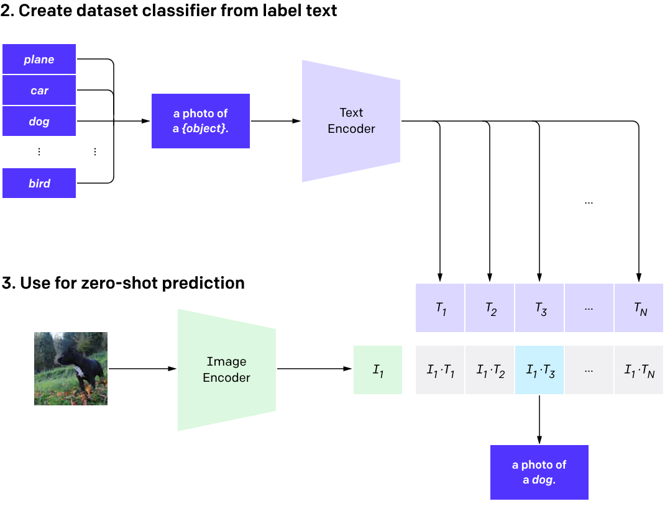
How does CLIP Predict?
https://openai.com/research/clip
Notes:
After the model is trained, let us look at how to use CLIP model
Here our task is to classify an image

Slide 8
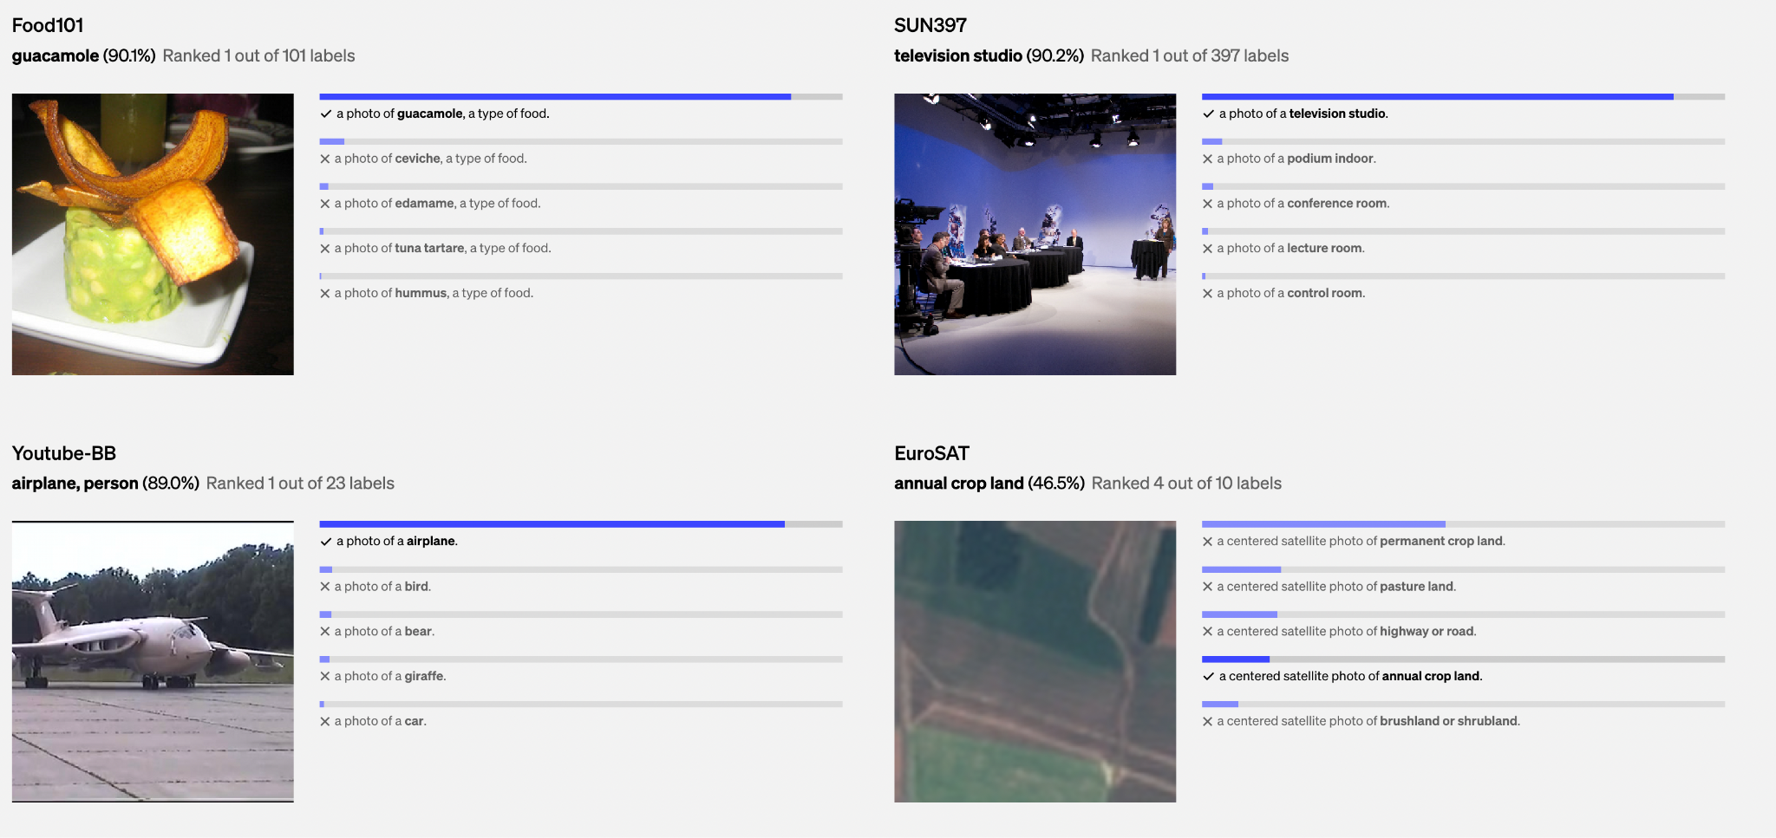
Results of CLIP
https://openai.com/research/clip

Slide 9
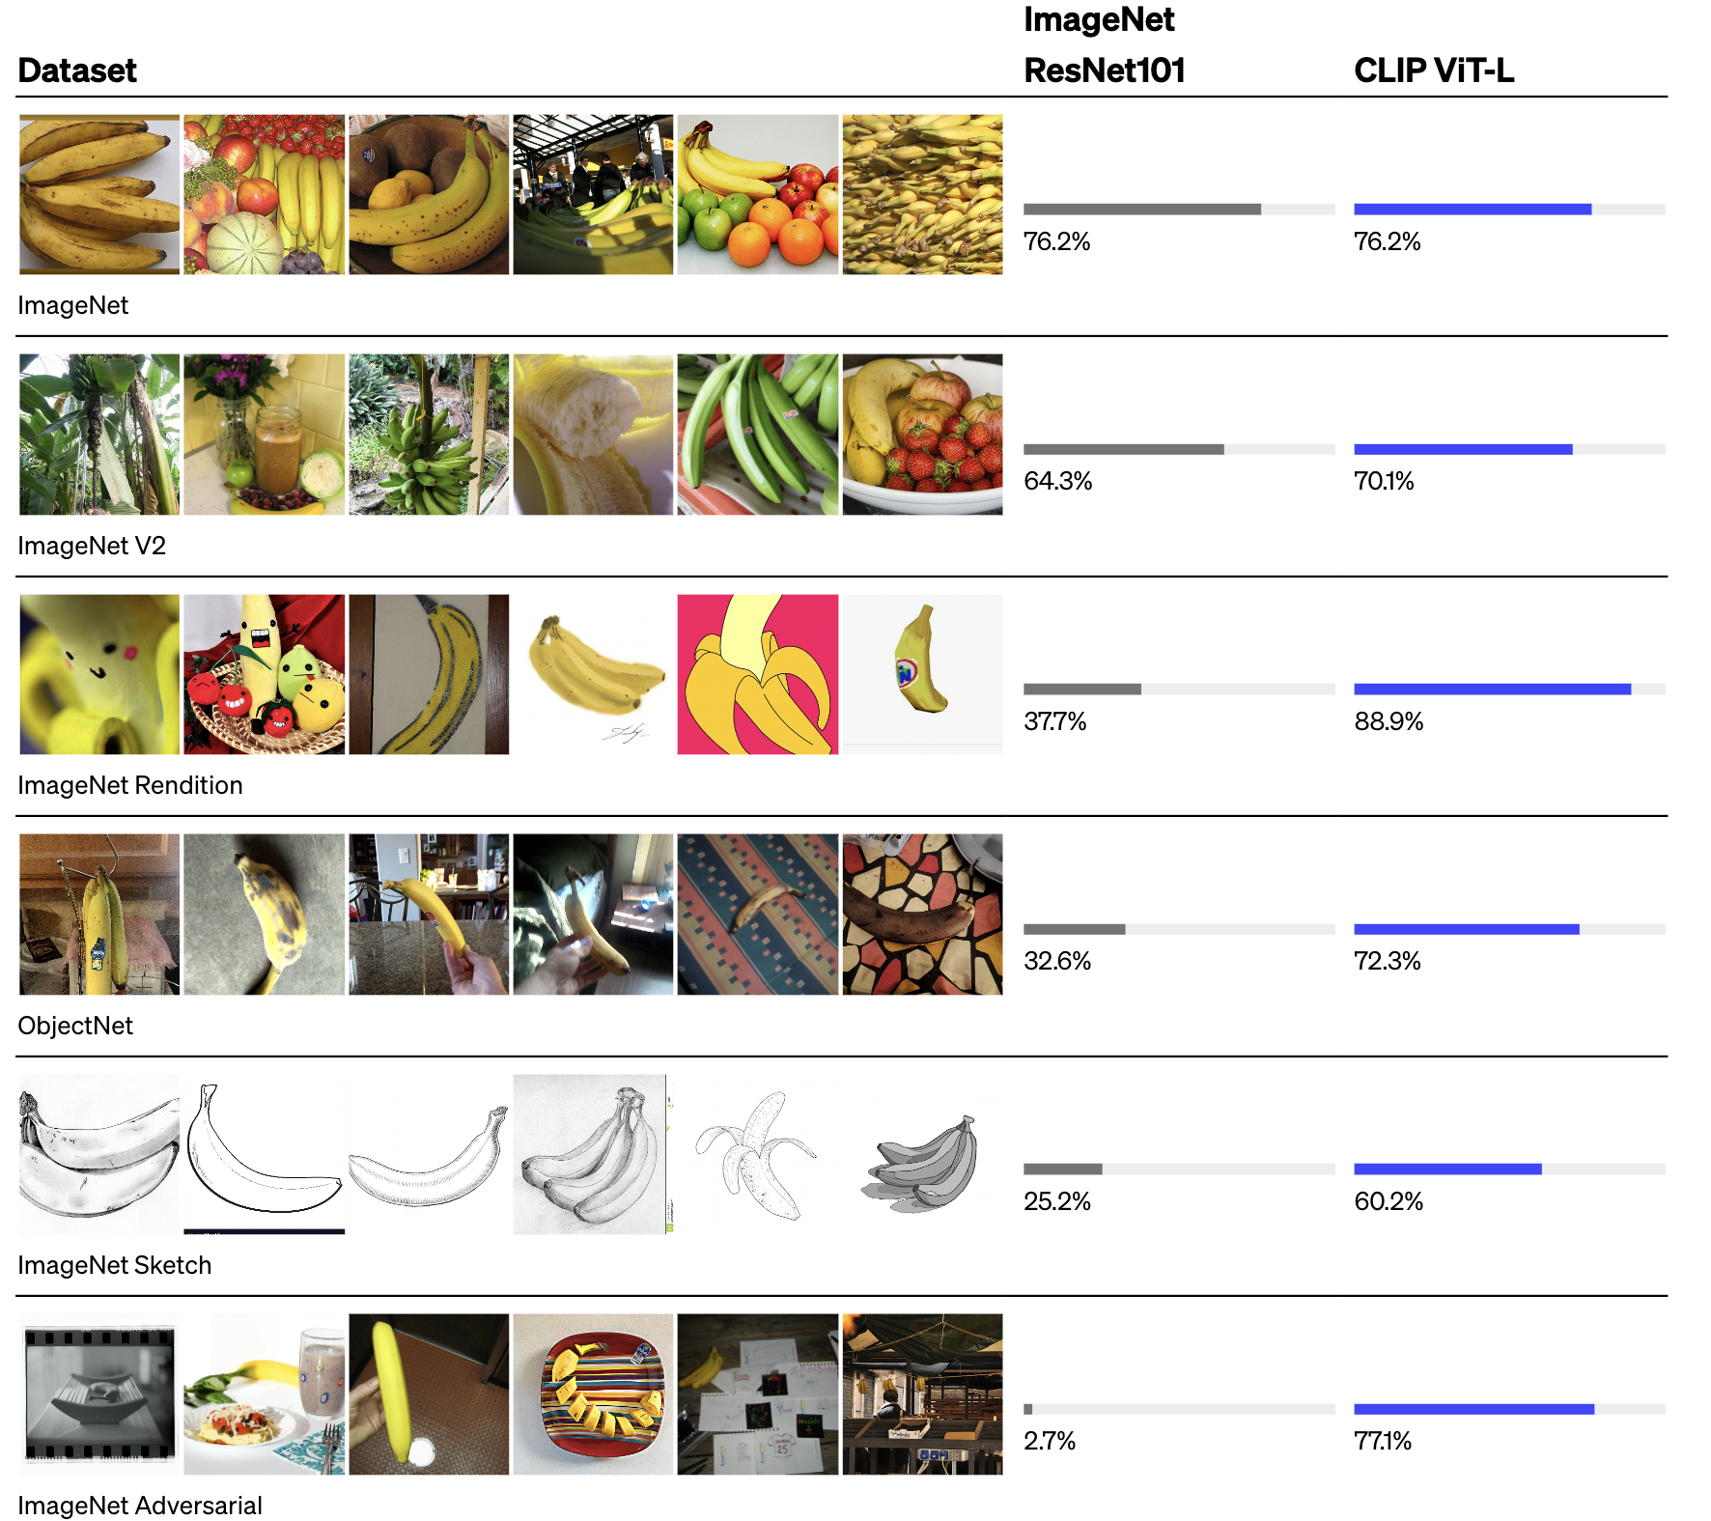
Results of CLIP
https://openai.com/research/clip

Slide 10
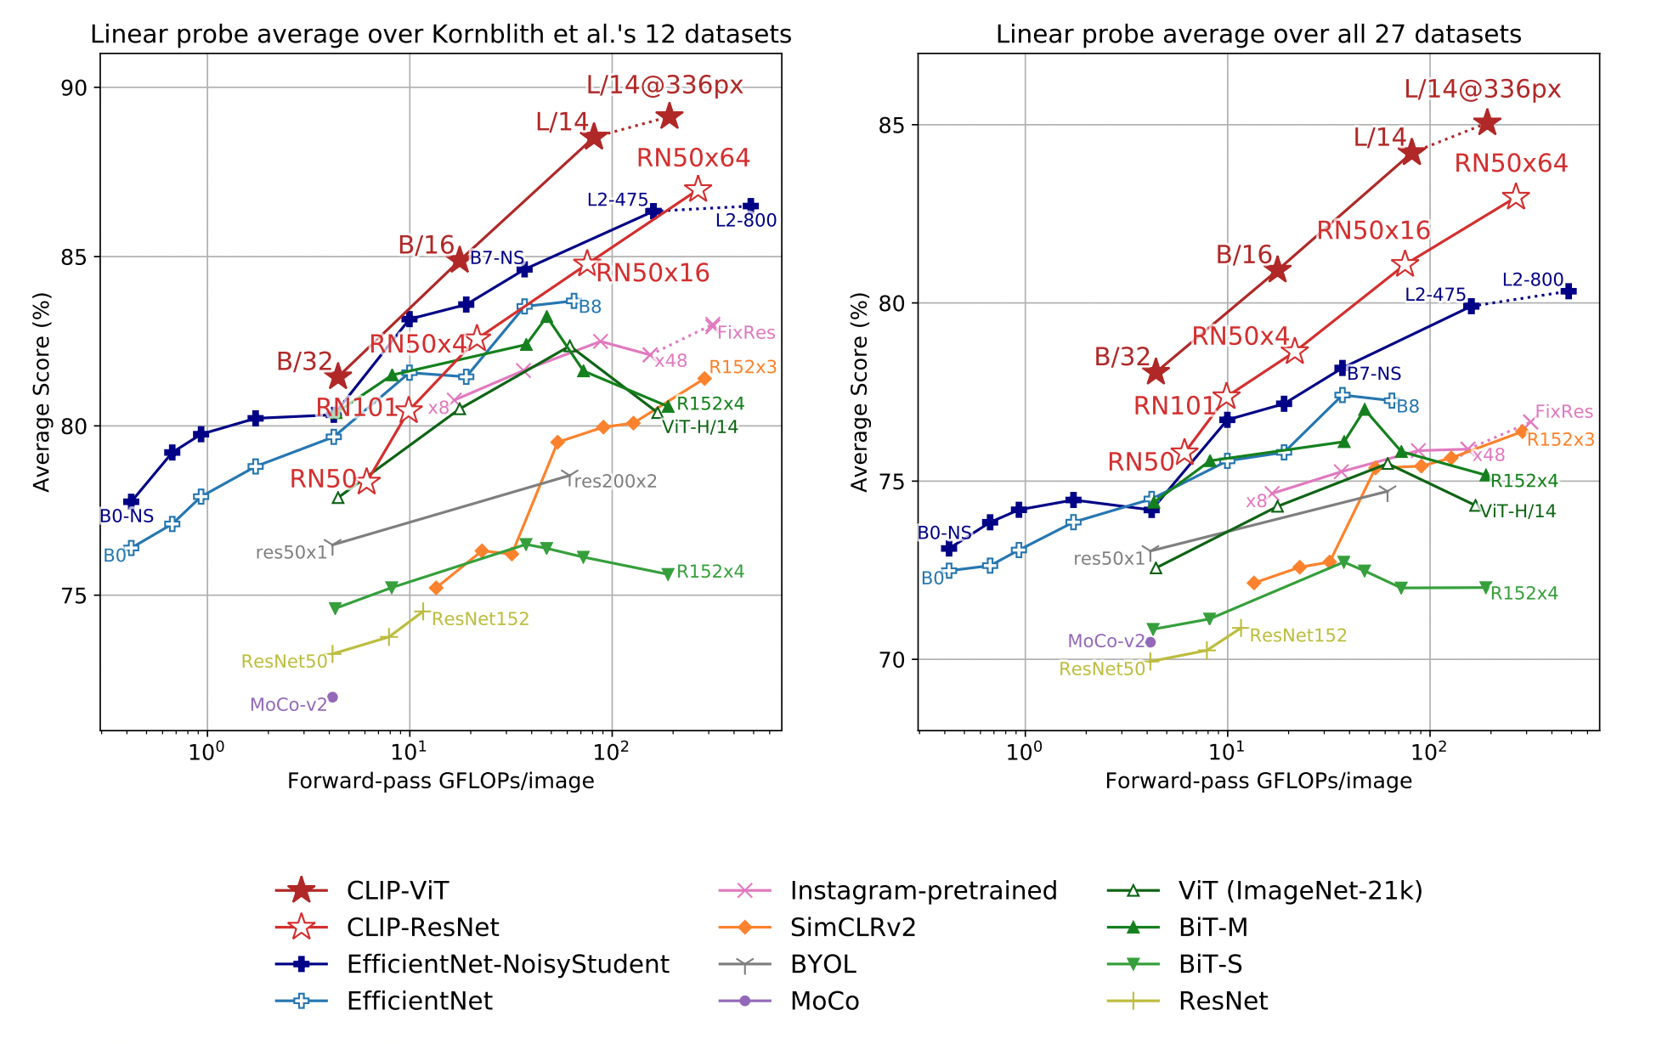
Experiment Results of CLIP
Learning Transferable Visual Models From Natural Language Supervision
Notes:
Figure 10. Linear probe performance of CLIP models in comparison with state-of-the-art computer vision models, including
Left) Scores are averaged over 12 datasets studied
(Right) Scores are averaged over 27 datasets that contain a wider variety of distributions.
Dotted lines indicate models fine-tuned or evaluated on images at a higher-resolution than pre-training.

Slide 11
Recap: Why does CLIP Matter?
Bridge Visual and Textual Understanding
Zero-Shot Learning Capabilities
Robustness Against Adversarial Attacks
Training data efficiency
Notes:
CLIP represents a major step forward in multimodal learning, effectively bridging the gap between visual perception and language understanding. This integration allows the model to comprehend and interpret images in the context of natural language, which is much closer to how humans perceive and describe visual content.
Zero-Shot Learning Capabilities:
One of CLIP’s most significant contributions is its ability to perform zero-shot learning – making accurate predictions for tasks it was not explicitly trained for.
Robustness Against Adversarial Attacks:
CLIP has shown greater robustness against adversarial examples compared to traditional models. This robustness is critical for deploying AI models in real-world applications where reliability is key.
Reducing Dependency on Large Labeled Datasets:
Traditional visual models often require large, task-specific labeled datasets. CLIP, through its contrastive learning approach, making it more feasible to develop powerful models without the need for extensive data labeling.

Slide 12
Training Resources for CLIP
Training data size: 400,000,000 image-text pairs.
Training time: 30 GPU days across 592 V100 GPUs.
Training cost: $1,000,000 on AWS on-demand instances

Slide 13
Challenges and Limitation of CLIP
Computation-Intensive
Struggles on more abstract or systematic tasks
Count the number of objects in an image
Predict how close the nearest car is in a photo.
CLIP also still has poor generalization to images not covered in its pre-training dataset.
Sensitive to wording or phrasing
https://openai.com/research/clip
Notes:
Computation-Intensive
Large-Scale Datasets– to achieve zero-shot capability
Advanced Model Architecture:
Zero-shot CLIP also struggles compared to task specific models on very fine-grained classification, such as telling the difference between car models, variants of aircraft, or flower species.
Finally, we’ve observed that CLIP’s zero-shot classifiers can be sensitive to wording or phrasing and sometimes require trial and error “prompt engineering” to perform well.

Slide 14
Follow-up Works of CLIP
Object detection
Image segmentation
Motion detection
Video/Image search
Multimodality
Image generation
…

Slide 15
Q&A

